Slide 1
PRESENTATION ON SPAM DETECTION
PRESENTED BY TEAM
CS7: RUNTIME TERROR
TEAM -
Yash Goyal
Tushar Khatri
Vishal Kumar Mahto
Yassasvini Bandreddi
Vamsi Bodi
Mentor -
Divya Prakash M

Slide 2
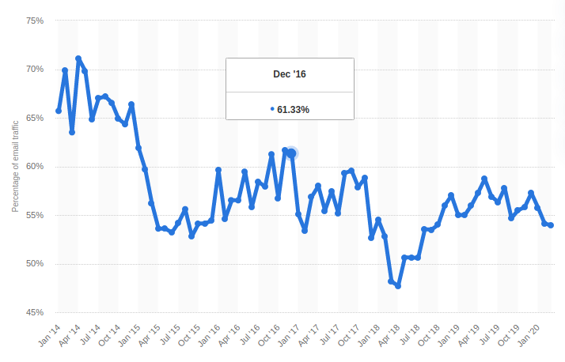
SPAM STATISTICS
Mar ‘20
53.95%

Slide 3
SPAM VS HAM
SPAM – (Unwanted Communication) Spam is any kind of unwanted, unsolicited digital communication, often an email, that gets sent out in bulk. Spam is a huge waste of time and resources.
HAM – (Normal Communication) E-mail that is wanted by the recipient and is not considered spam.

Slide 4
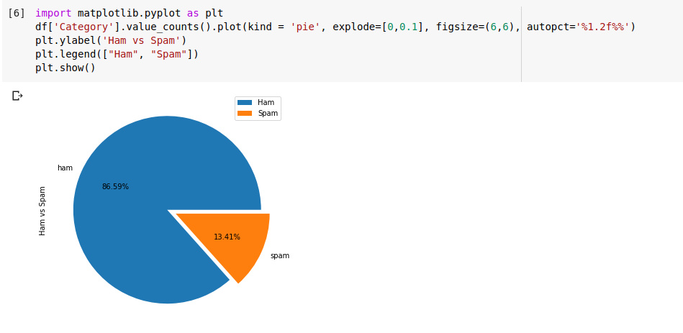
SPAM VS HAM
86.59% of the messsages are ham and 13.41% are ham in our Dataset.

Slide 5
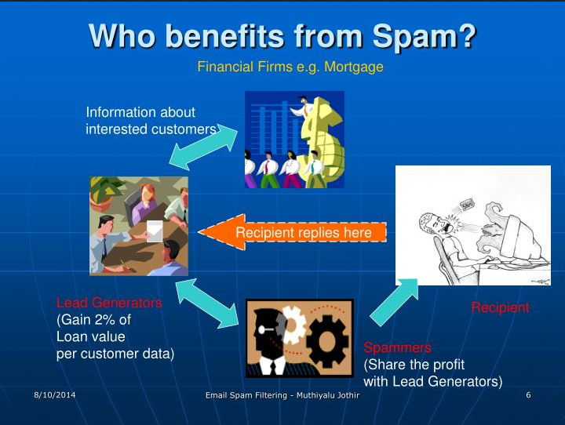
Who benefits from Spam?

Slide 6
PROBLEM STATEMENT
Unwanted Emails/SMS irritating internet connection.
Critical e-mail message are missed and / or delayed.
Millions of compromised computers.
Billions of dollars lost worldwide.
Identity theft.
Spam can crash mail servers and fill up hard drives.
Increase in Worms and Trojan Horses.
Loss of Internet performance and bandwidth.

Slide 7
OBJECTIVE
The objective of identification of Spam e-mails are:
To give knowledge to the user about the fake e-mails and relevant e-mails.
To classify that mail spam or not.

Slide 8
REQUIREMENT ANALYSIS
Functional Requirements -
To classify the e-mails which is done by first taking out the feature vector extraction which involves first taking out whether the word is a spam or not.
Non-Functional Requirements -
Ensures high availability of email data here datasets.
User should get the result as fast as possible.
It should be easy to use i.e., user is just required to type the words and click then the result is displayed or user is just required to enter a pair of reasonable sentence.

Slide 9
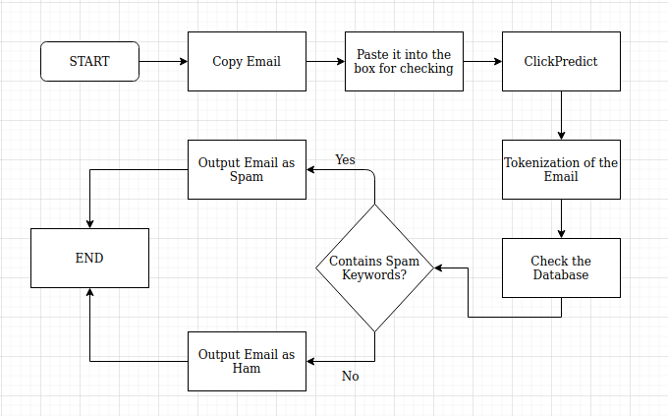
WORKFLOW

Slide 10
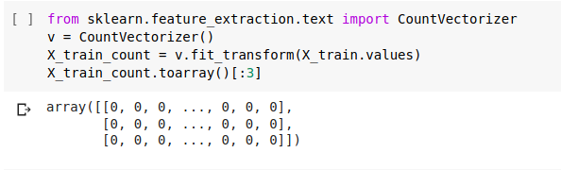
PRE-PROCESSING
TOKENIZATION
Tokenization is the process of breaking a stream of text up into words, phrases, symbols, or other meaningful elements called tokens.
The list of tokens becomes input for further processing such as parsing or text mining.

Slide 11
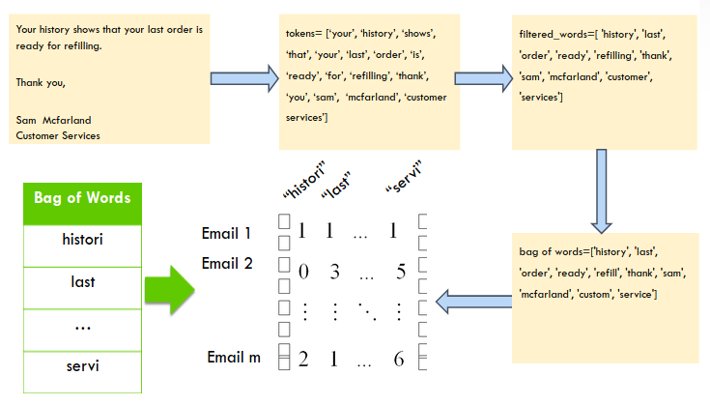
How TOKENIZATION works?

Slide 12


NAIVE BAYES
Use Bayes Theorem:
Hypothesis (H): spam or not spam.
Event (e): word occurs.
For example, the probability an email is spam when the word “free” is in the email.
“Naïve” : assume the feature values are independent of each other.
It is very useful to classify the e-mails properly.

Slide 13
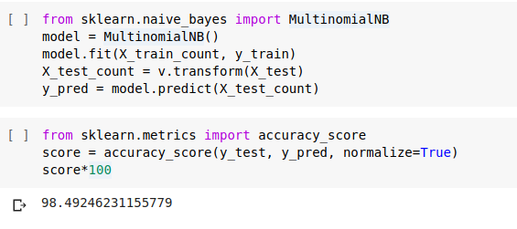
OUTPUT
Performance Measures:
Accuracy: 98.49% of the predictions were correct.

Slide 14
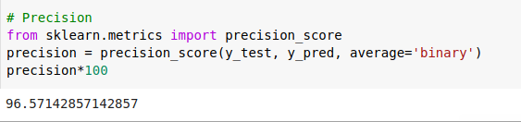
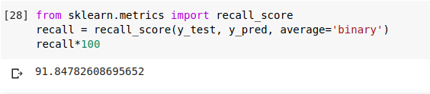
OUTPUT
Precision: 96.57 % of emails classified as spam that were actually spam.
Recall: 91.84% of spam emails that were predicted correctly.

Slide 15
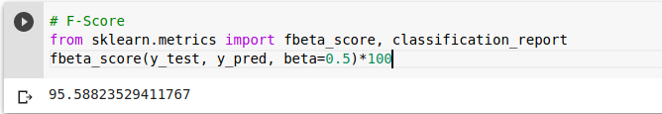
OUTPUT
F-Score:
weighted average of precision and recall. i.e, 95.58%.

Slide 16
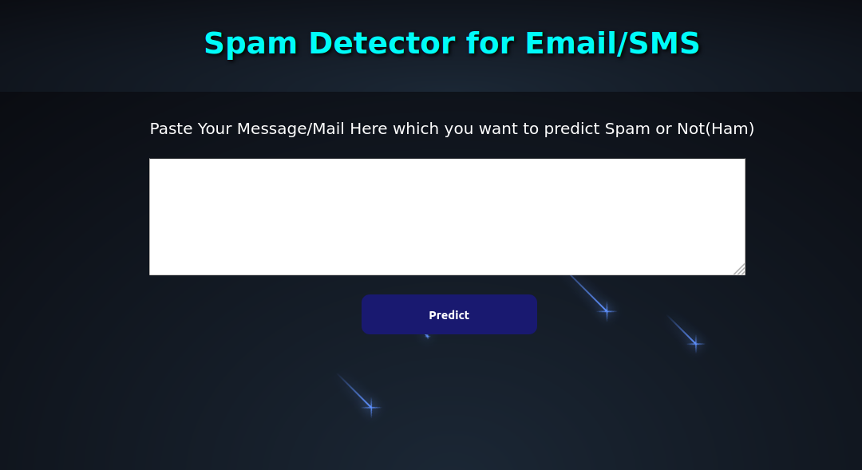
WEBSITE
https://detectspamham.herokuapp.com/.

Slide 17
CONCLUSION
Spam emails not only consume computing resources, but can also be frustrating. Our Spam Detection System is highly scalable. Data Mining approaches for content based spam filtering seem promising.
LIMITATION OF THE PROJECT:
Our project is capable of Filtering of spams on the basis of its contents only. Therefore it, at this stage is not able to Filter the emails on the basis of domail names.
FUTURE ENHANCEMENTS:
There is a widescope of enhancement in our project. Filtering of emails can be done on the basis of domail names by the putting mails in blacklist that are spam.

Slide 18
REFERENCES
https://www.statista.com/statistics/420391/spam-email-traffic-share/
http://www.mecs-press.org/ijitcs/ijitcs-v8-n1/IJITCS-V8-N1-2.pdf
https://image1.slideserve.com/3121305/who-benefits-from-spam-n.jpg
http://www.ijitee.org/wp-content/uploads/papers/v9i2/B9001129219.pdf
https://www.slideshare.net/nabinsjamkatel/spam-email-identification

Slide 19
THANK YOU

